Slide 1
💍Ring Attention
Sequence Parallel Attention Across Devices
CUDA-MODE Lecture 13
Andreas Köpf
April 06, 2024

Slide 2
Overview
Motivation: Long Context Transformers & Applications
Recap: Vanilla Attention, Online Softmax, Log-Sum-Exp
Ring Attention 💍
Striped Attention 🦓
Flash Decoding ⚡

Slide 3
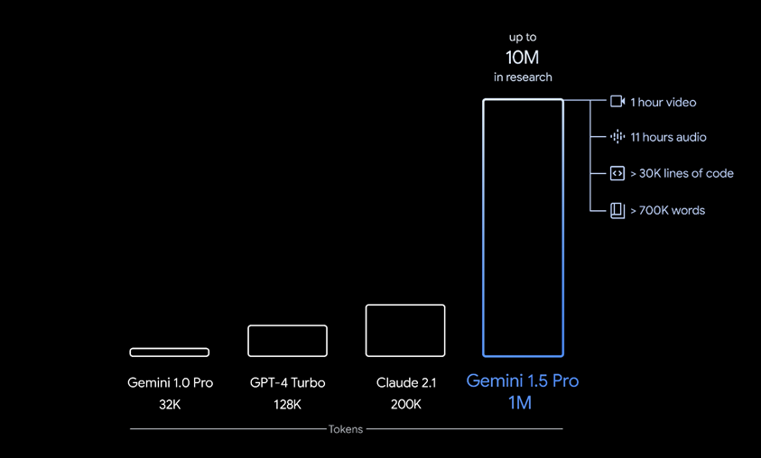
The Era of Long Context LLMs
MPT (65k, ALiBi)
GROK-1 (8K)
DBRX
Yarn-Mistral-128k
LWM -1M
Source: Google Blog

Slide 4
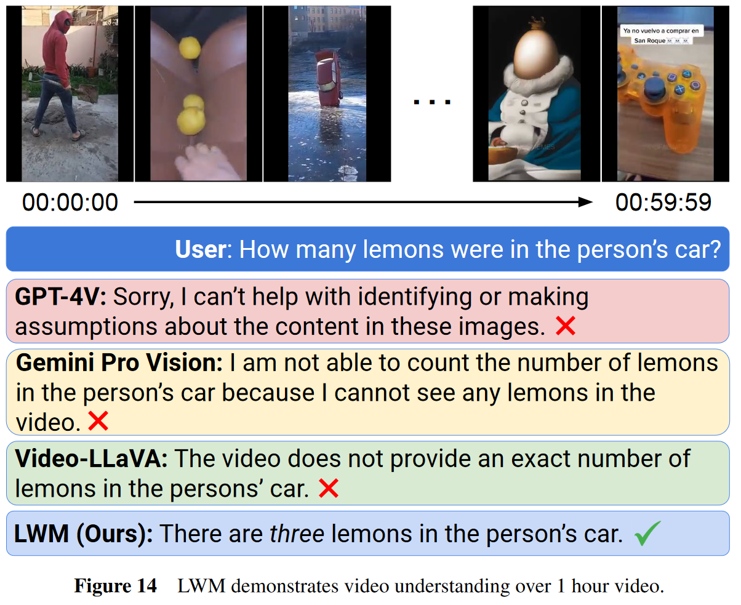
Long-context Magic 🪄
Allows to process…
books, long documents
web content
chat histories
code bases
high-res images
audio recordings
videos
… towards multi-modal world models
More on LWM: largeworldmodel.github.io

Slide 5
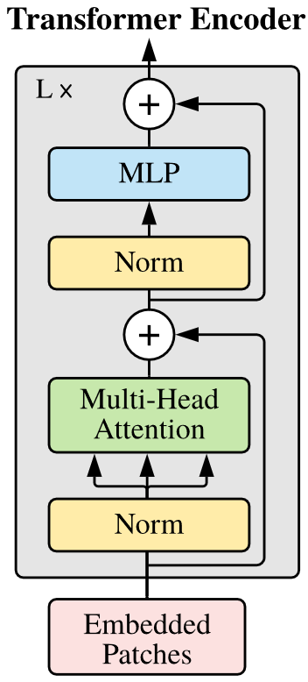
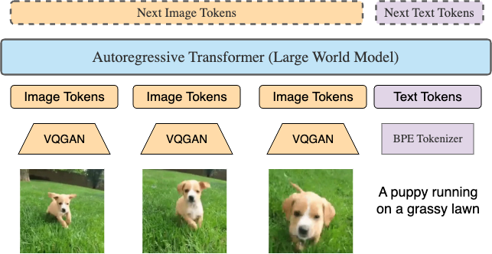
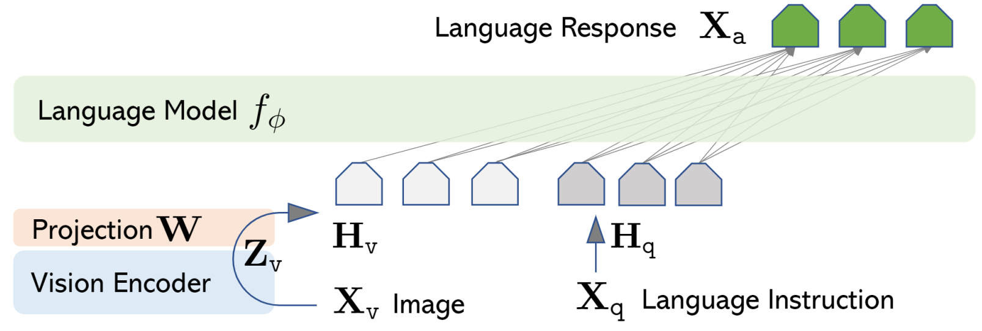
Multimodal - Any-to-Any Autoregressive Predictions
LWM: text, image, video,
video-text,
text-video,
image-text,
text-image
LLaVA:
image-text

Slide 6
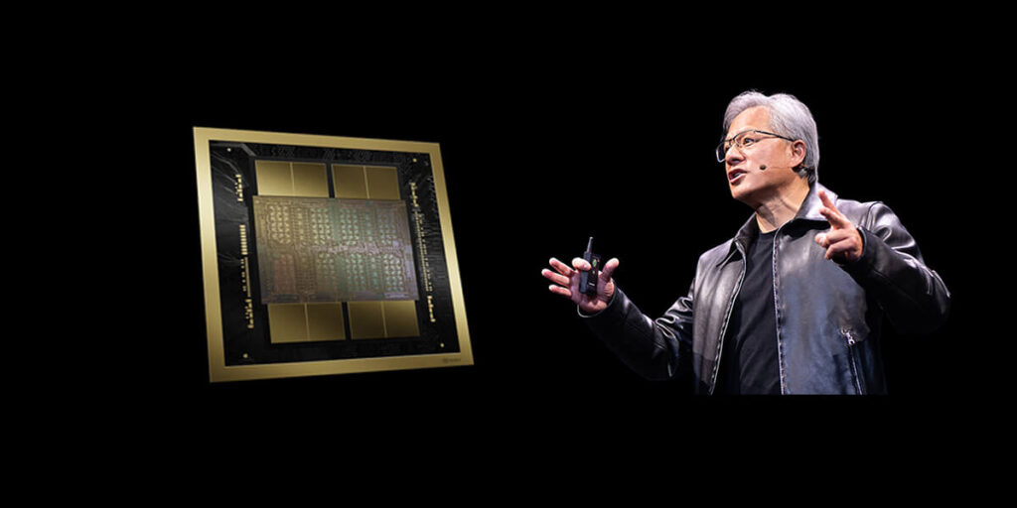
Challenge: We Run Out of Memory
"with a batch size of 1, processing 100 million tokens requires over 1000 GB of memory for a modest model with a hidden size of 1024"
Ring Attention, 2023, Hao Liu et al.
Input has to be materialized:
Memory scales linearly with Flash-Attention
- need to store input QKV + output + LSE + dout for backward Memory of current high-end GPUs:
NVIDIA H200: 141 GB
AMD MI300X: 192 GB
NVIDIA GB200 (Blackwell): 288 GB (available late 2024)

Slide 7

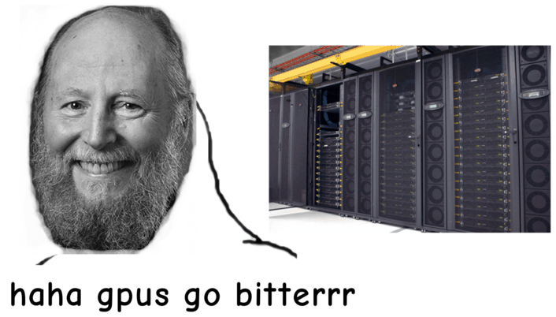
Approaches to Attention for Long Contex
A) Approximation (e.g. Sparse, LoRA)
B) RAG / Vector-DBs (ANN search, LSH)
C) Brute-force compute (tiling, blockwise)

Slide 8
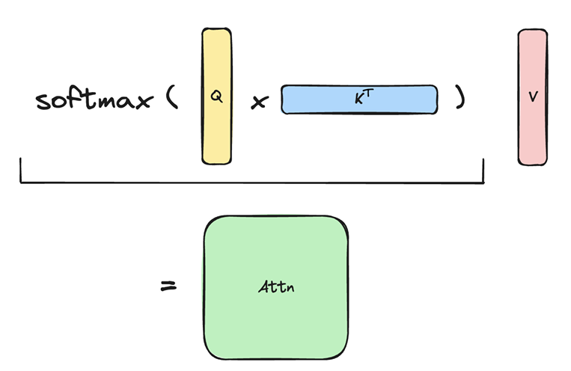
Vanilla Attention
softmax(QK^{T})V
Memory complexity of naive attention is quadratic with sequence length (score matrix & softmax output).
s × s

Slide 9
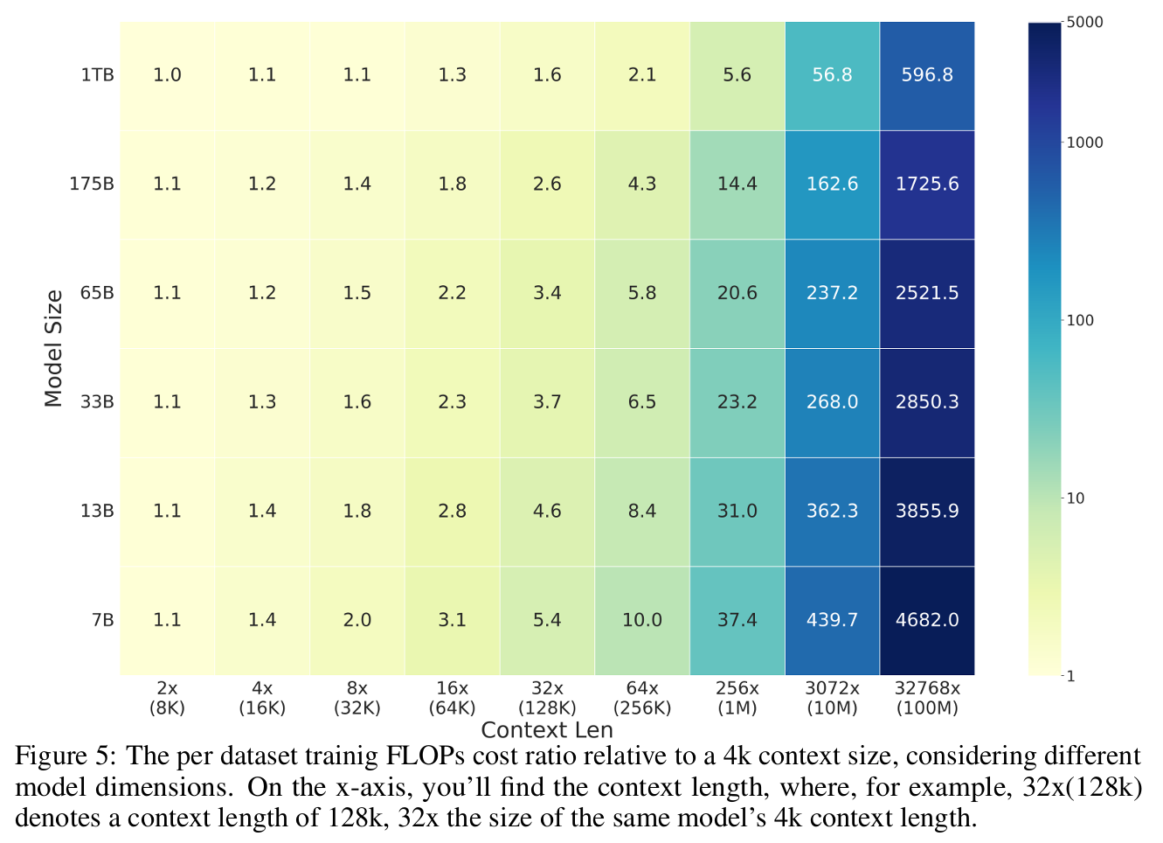
How bad is it? FLOPS Scaling per Token
Surprisingly:
“as the model sizes increase, the cost ratio decreases”
FLOPS: 24sh² + 4s²h
(s=seqlen, h=hidden-dim)
given constant h: O(s²)
-> sequence length will catch you - but maybe later than you thought.
Source: Ring Attention, Appendix D

Slide 10
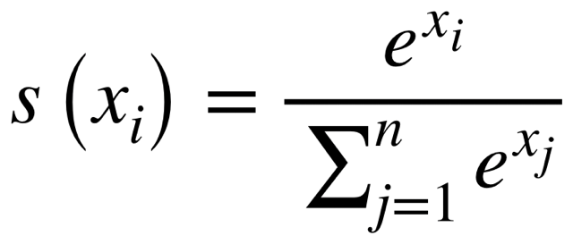
The Crux of Attention: softmax
Challenge: The softmax operation needs to be computed over full rows of the score matrix S = QK^T, outputs depend on the sum in the denominator.
For FlashAttention & RingAttention we need to compute the softmax part blockwise/online - i.e. with parts of this sum!

Slide 11
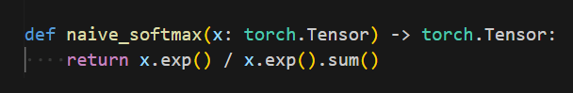
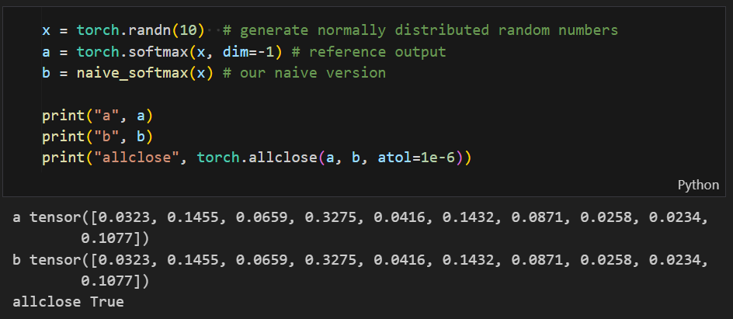
Towards Log-Sum-Exp Update - Step-by-Step
Let’s start by defining a naive softmax function …
… and verifying that its output matches the output of the official torch.softmax() function:

Slide 12
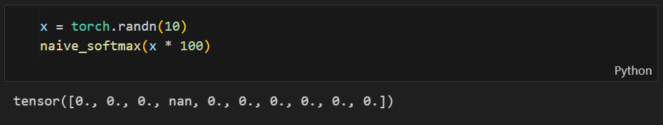
Naive & Numerical unstable
Our naive softmax function has a problem when it gets input vectors with larger elements:
Before we to fix this let's first look how a block-wise computation of softmax can be realized ...

Slide 13
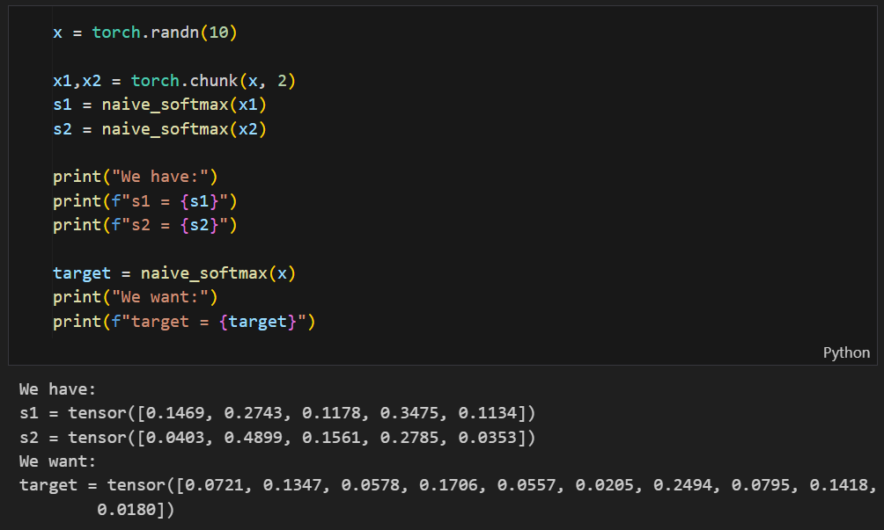
Goal: Breaking softmax() into chunks
We generate a vector and split it into two chunks of equal size and compute softmax on each chunks individually…
But how to compute target from s1 & s2?

Slide 14
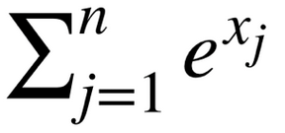
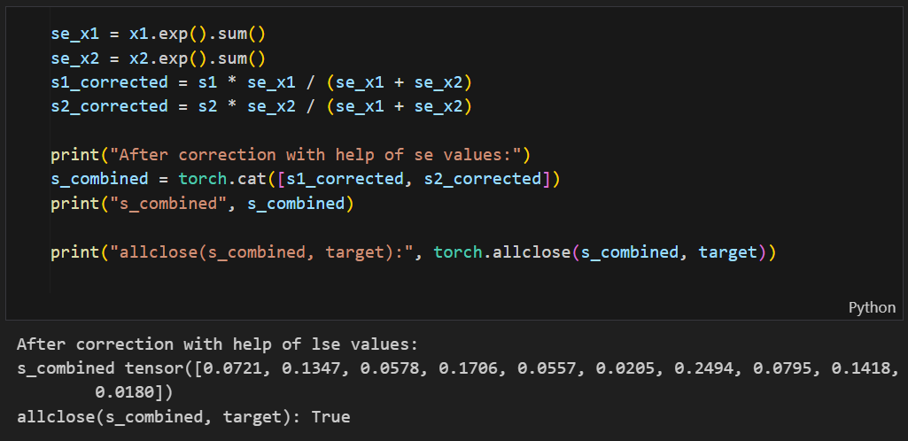
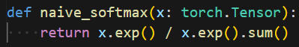
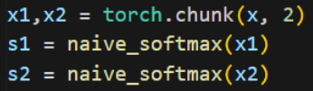
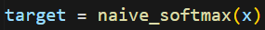
Undo normalization with “sum exp”
The softmax output had been divided by `x.exp().sum()`. If we have this value for each chuck we can “undo" the softmax normalization and combine multiple chunks.
from last slides we have:

Slide 15
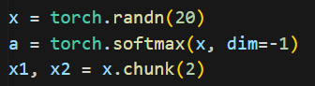
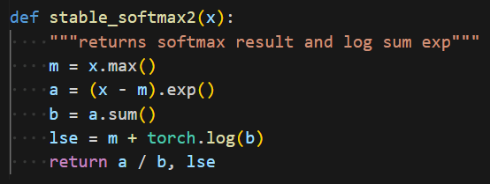
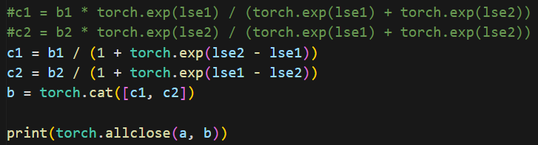

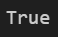
Combining blocks numerically stable
Create test input & output
Define stable_softmax2() function
Combine blockwise with help of log-sum exp.
a/(a+b) = 1/(1+b/a)
Trick: Do divisions as subtraction in log-scale.
Much stable!

Slide 16
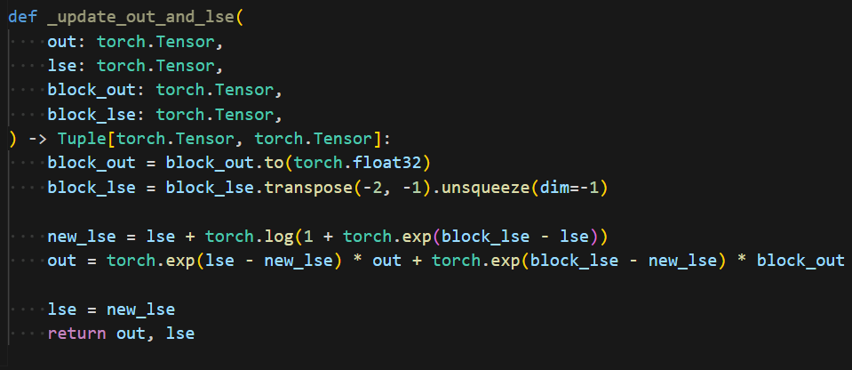
Same trick can be used for RingAttention
internal flash attention functions return the log-sum-exp
allows us to compute attention value projection blockwise/incrementally
Attention value projection is linear, i.e can be corrected in same way as direct softmax block outputs.
https://github.com/zhuzilin/ring-flash-attention/blob/55ff66fd35f329dfcc24ce7a448bfdd532865966/ring_flash_attn/utils.py#L10-L24

Slide 17
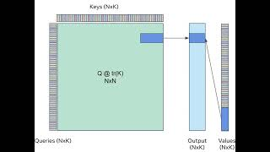
Blockwise Output updates Animated
Source: tweet @fvsmassa

Slide 18
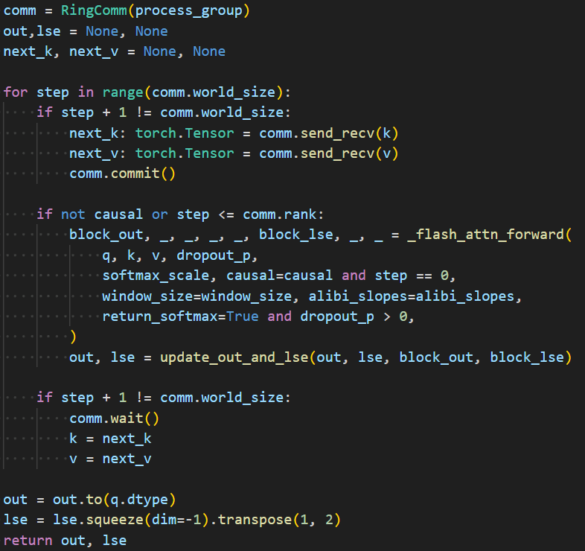
Applied in zhuzilin / ring-flash-attention
zhuzilin/ring-flash-attention is an excellent open-source ring attention using Tri Dao flash-attention for inner blocks.
OK, now we have already peeked into the inner core of ring-attention.
But what is RingAttention?

Slide 19
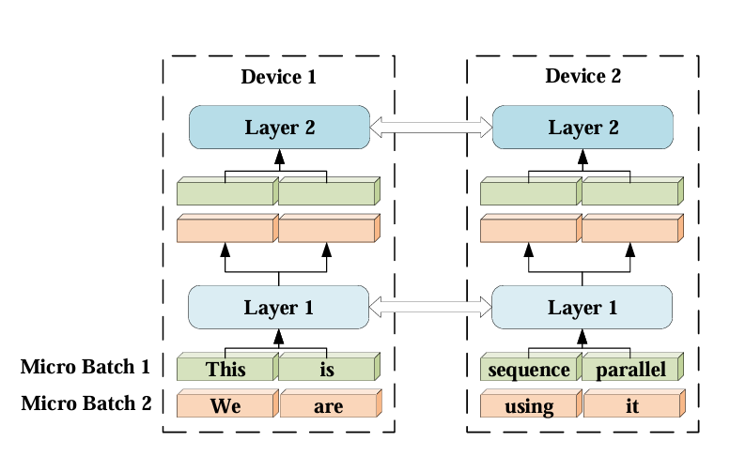
Sequence Parallelism
Fig: Sequence Parallelism
Batches are spread along sequence dimension evenly across devices.

Slide 20
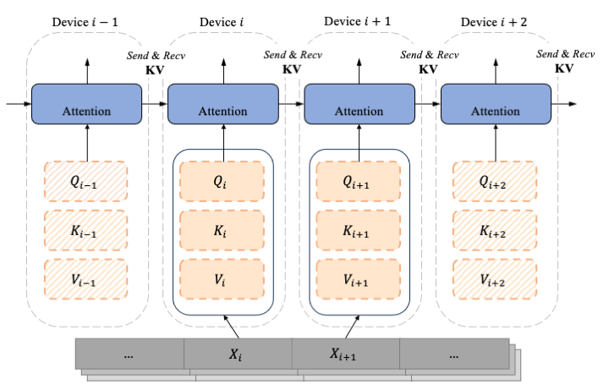
Sequence Parallelism For Attention
QKV split across devices
Adapted from LASP

Slide 21
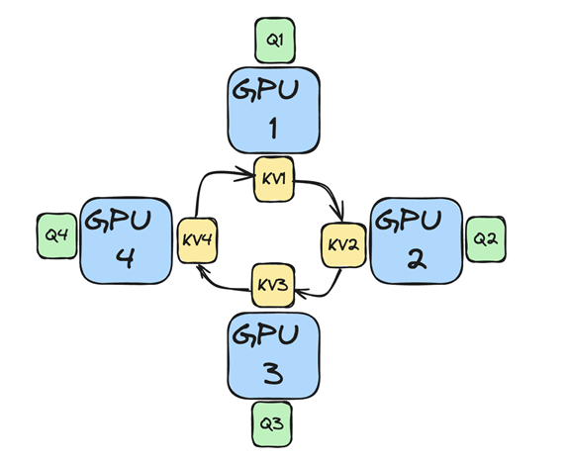
Ring Attention - Main Concept
order of block computations can be arbitrary
split QKV sequence across N hosts
hosts form a conceptional ring to exchange KV segments
one pass completes when every node has seen all parts of the KV
zero overhead for longer sequences: overlap computation and communication

Slide 22
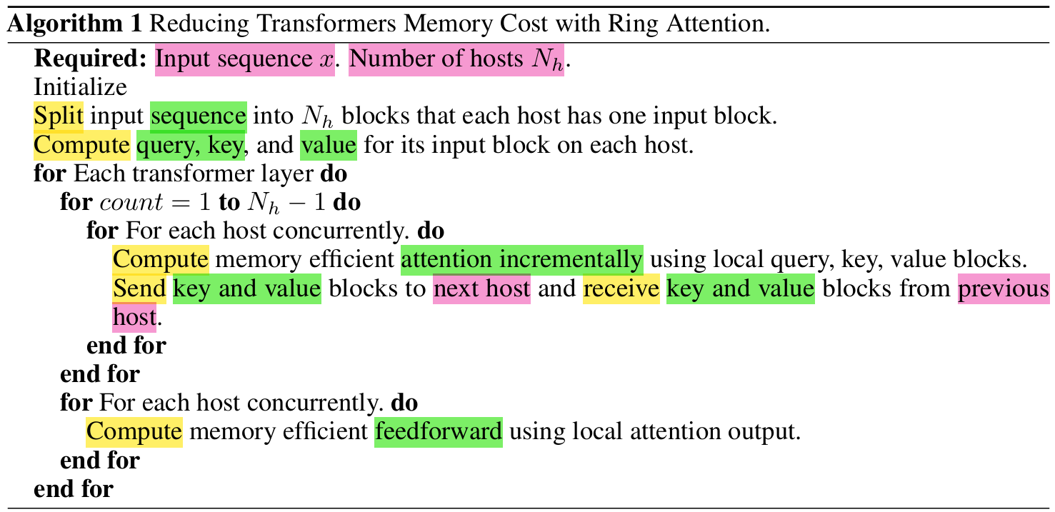
Ring Attention Algo

Slide 23
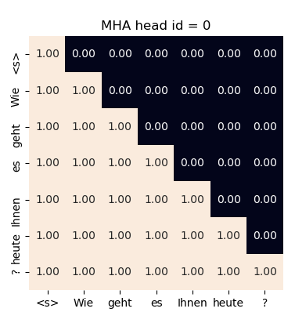
Recap: Causal Masking for Autoregressive Models
mask 0 becomes -inf, softmax output: 0
required to support auto-regressive decoding
outputs depend only on current and previous inputs
attention score becomes: dot(Q_i, K_ j) if i <= j else -inf
no need to materialize mask: computed on the fly in kernel
kernels like flash attention skip completely masked key blocks
Q_i
K_ j
Attention Mask

Slide 24
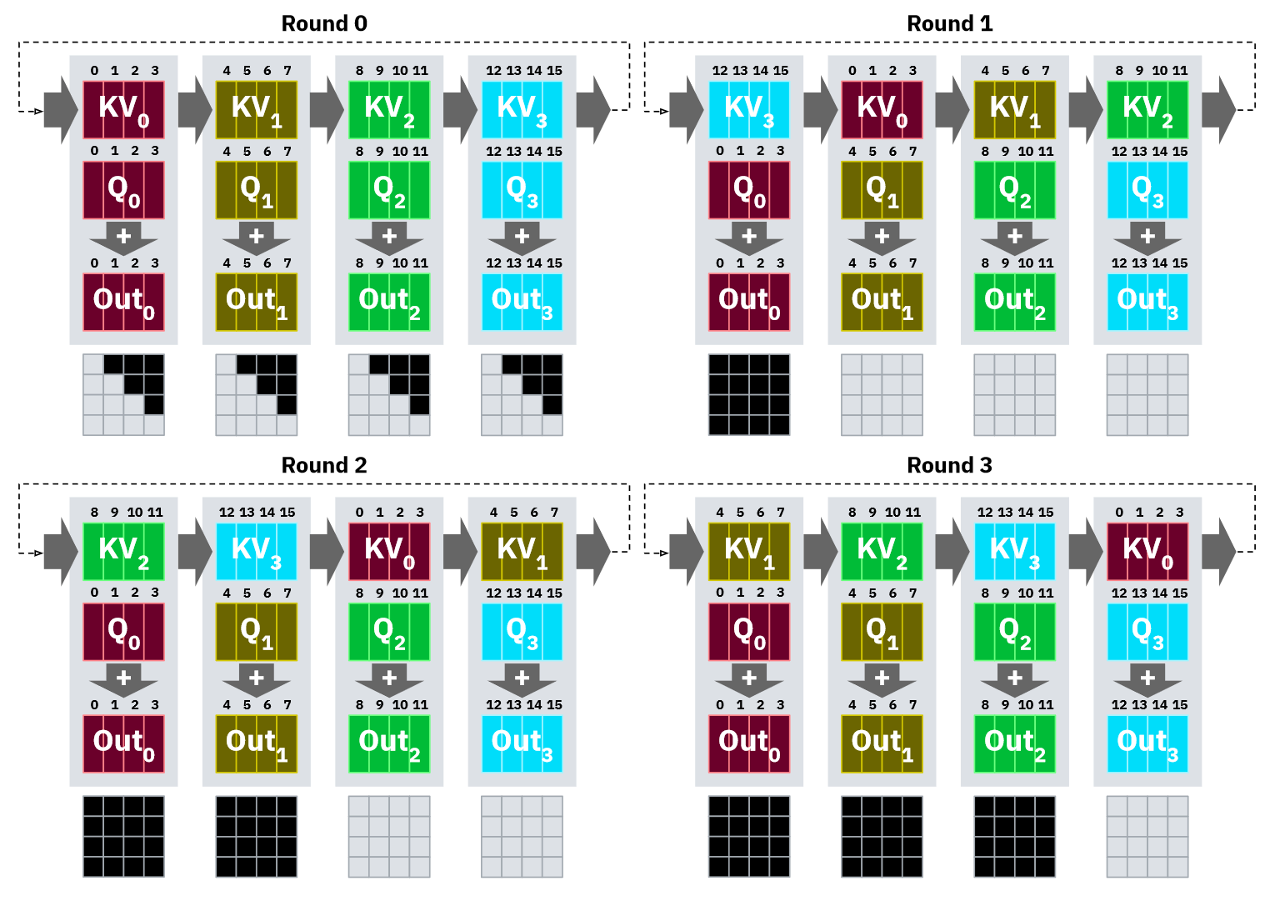
Ring Attention Problem:
Devices idle when causally masking, i.e for all auto-regressive models (very common)
output is 0 if Query_index < Key_index
slowest ring host determines pace

Slide 25
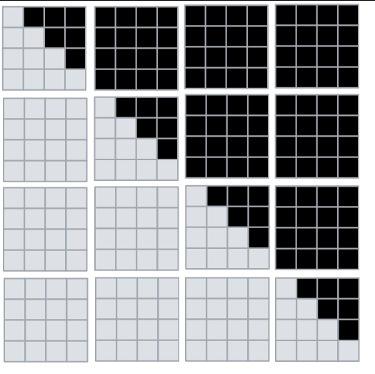
A
B
C
D
E
F
G
H
A
F
K
P
D
E
J
O
Q
I
J
K
L
M
N
O
P
K
Causal mask chunks applied in different RingAttention rounds
C
H
I
N
B
G
L
M

Slide 26
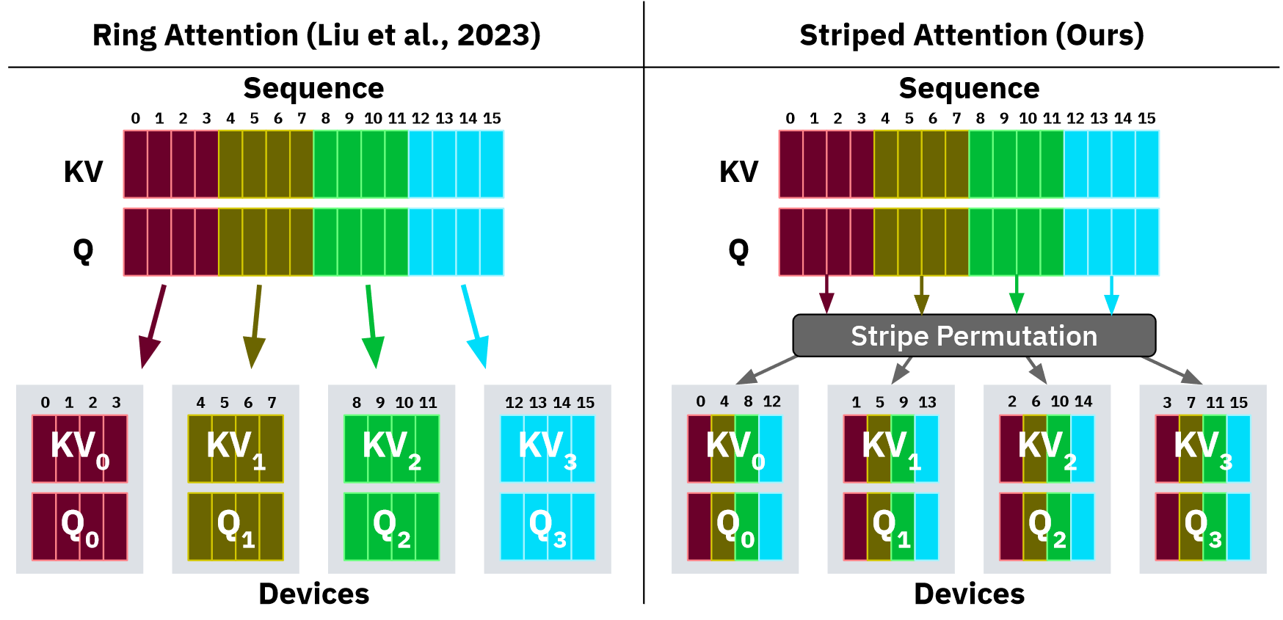
Solution: 🦓 Striped Attention (Reorder QKV)

Slide 27
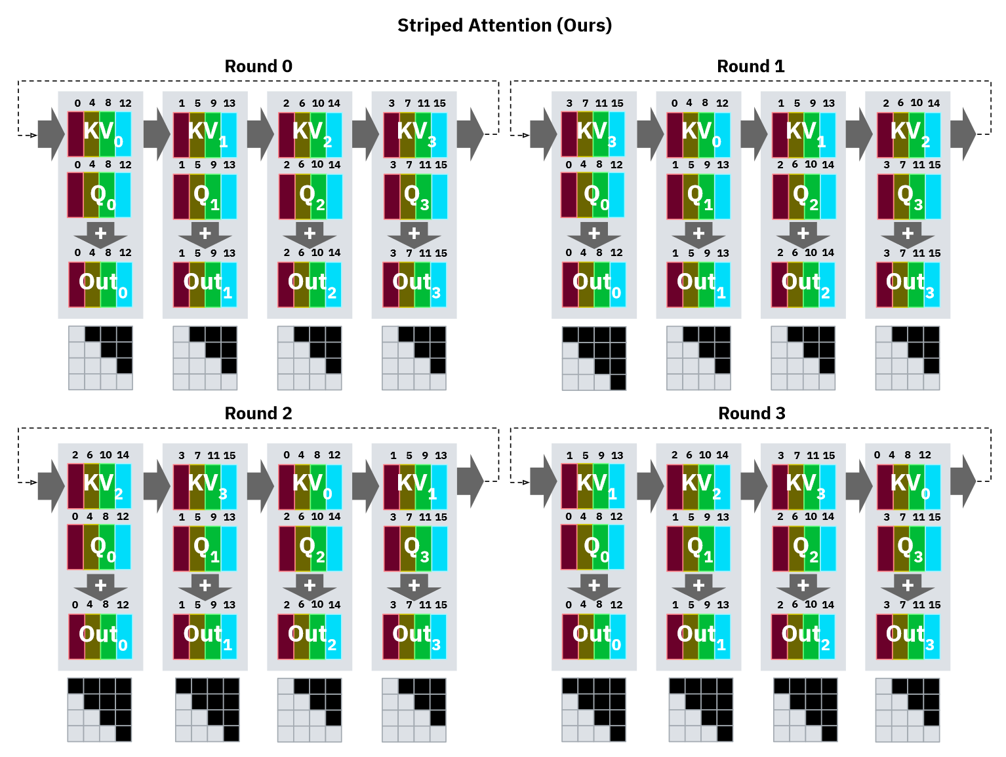
After reordering QKV the computations are almost perfectly distributed.
We need only to drop the first query and last key if host_id < round and can then use a standard causal flash attention kernel to compute the block.

Slide 28
FlashAttenion: Sub-optimal for Long-Context Inference
FlashAttention parallelizes across blocks of queries and batch size only, and does not manage to occupy the entire GPU during token-by-token decoding.
Decoding with Flash Attention
Animation: Stanford CRFM Blog Flash-Decoding

Slide 29
Solution: Flash-Decoding
Flash-Decoding, Dao et al.

Slide 30
That’s all for today…
History / Papers
May 2022, Tri Dao et al. FlashAttention: Fast and Memory-Efficient Exact Attention with IO-Awareness
Aug 2023 Hao Liu et al. Blockwise Parallel Transformer for Large Context Models
Nov 2023, Hao Liu et al. Ring Attention with Blockwise Transformers for Near-Infinite Context
Nov 2023, Brandon et al. Striped Attention: Faster Ring Attention for Causal Transformers
Feb 2024, Hao Liu et al. World Models on Million-Length Video and Language With RingAttention
Code:
🌟 zhuzilin / ring-flash-attention
cuda-mode/ring-attention: howto_log_sum_exp.ipynb

